Slide 1


ROCKET SCIENCE WITH DATA SCIENCE
Arturo León 2024-03-06

Slide 2
Outline
Executive Summary
Introduction
Methodology
Results
Conclusion
Appendix
2

Slide 3
Executive Summary
The data analysis was carried out through the following processes:
Gathering data through the means of web scraping and the SpaceX API;
Engaging in Exploratory Data Analysis (EDA), which encompassed the processes of data wrangling, creating data visualizations, and employing interactive visual analytics;
Utilizing Machine Learning for predictive analysis.
In summarizing the outcomes:
We were able to acquire substantial data from publicly available sources;
EDA techniques helped in pinpointing the key features to forecast the success of rocket launches;
Predictive Machine Learning identified the optimal model to ascertain the critical attributes that can capitalize on this opportunity most effectively, based on the entirety of the data gathered.
3

Slide 4
Introduction
The aim is to assess whether the emerging company Space Y can be a contender against Space X in the aerospace industry.
Sought-after responses include:
A superior method to gauge the aggregate expenditure for space missions, which involves forecasting the first stage landings of rockets successfully;
Identifying the prime location for conducting space launches.
4

Slide 5

5

Slide 6
Methodology
In the executive summary:
The data collection process was two-pronged, utilizing:
The Space X API available at their official API endpoint;
Web scraping from the Wikipedia page listing Falcon 9 and Falcon Heavy launches.
Subsequent data manipulation involved:
Augmenting the dataset by generating a label for the landing outcomes based on the summarized and analyzed outcome data.
For the exploratory data analysis (EDA):
Techniques including visualization and SQL queries were employed to examine the data thoroughly.
6

Slide 7
Methodology
The executive briefing includes the following points:
Interactive visual analytics were conducted using Folium for mapping and Plotly Dash for creating interactive dashboards.
Predictive analytics were carried out with the use of classification models.
The collected data was standardized and segmented into training and testing sets. Four distinct classification models were then applied to the data. The precision of each model was assessed using various parameter configurations.
7

Slide 8
Data Collection
Data sets were collected from Space X API (https://api.spacexdata.com/v4/rockets/) and from Wikipedia (https://en.wikipedia.org/wiki/List_of_Falcon/_9/_and_Falcon_Heavy_launches), using web scraping technics.
8

Slide 9

Data Collection – SpaceX API
Requesting the API and parsing the data related to SpaceX launches.
SpaceX provides access to a publicly available API for the retrieval and subsequent use of data.
This API has been utilized as per an adjacent flowchart, following which the data has been stored persistently.
Filtering the dataset to only include Falcon 9 launches.
Addressing any missing values within the dataset
9

Slide 10

Data Collection - Scraping
Launch data for SpaceX is also available via Wikipedia, which can be downloaded, processed according to a specified flowchart, and then stored.
The Falcon 9 Launch Wiki page is requested.
All column names or variable names are extracted from the HTML table header.
A dataframe is then created by parsing the HTML tables that contain the launch data.
10

Slide 11

Data Wrangling
The data analysis commenced with an Exploratory Data Analysis (EDA) on the collected information.
Subsequently, comprehensive summaries were compiled detailing the number of launches at each site, as well as the frequency of various orbits and mission outcomes for each orbit classification.
To conclude, a label describing the outcome of the landings was derived from the 'Outcome' column in the dataset.
Creation of Landing Outcome Label
EDA
Summarizations
11

Slide 12
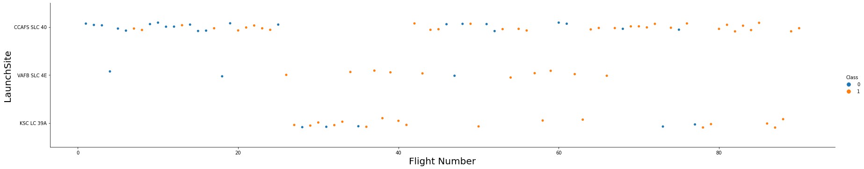
EDA with Data Visualization
Scatterplots and barplots were employed as visual tools to investigate the correlations between various feature pairs in the dataset. These comparisons included:
The relationship between Payload Mass and Flight Number,
The association of Launch Site with Flight Number,
The correlation between Launch Site and Payload Mass,
The interaction between Orbit type and Flight Number,
And the relationship between the Payload characteristics and Orbit type.
12

Slide 13
EDA with SQL
The executed SQL queries included:
Retrieval of the distinct names of launch sites used in space missions.
Identification of the top five launch sites with names starting with 'CCA'.
Calculation of the total payload mass lifted by NASA (CRS) mission boosters.
Computation of the average payload mass hoisted by the Falcon 9 version 1.1 booster.
Determination of the date on which the inaugural successful landing on a ground pad occurred.
Compilation of the list of boosters that successfully landed on a drone ship carrying a payload mass between 4000 and 6000 kg.
Tallying the total mission outcomes, categorized into successes and failures.
Identification of the booster versions that have transported the heaviest payloads.
Analysis of failed landing outcomes on drone ships, including specific booster versions and launch site names, within the year 2015.
Ranking of landing outcomes, such as failures on drone ships or successes on ground pads, within the timeframe from June 4, 2010, to March 20, 2017. 13

Slide 14
Build an Interactive Map with Folium
Within Folium Maps, the following visual elements were utilized:
Markers were placed to denote specific points of interest, such as launch sites.
Circles were drawn to highlight significant areas situated at particular coordinates, for instance, the NASA Johnson Space Center.
Marker clusters were created to represent collections of events situated at the same coordinates, which could be launches occurring at a single launch site.
Lines were incorporated to graphically represent the distances between pairs of coordinates.

Slide 15
Build a Dashboard with Plotly Dash
For the purpose of data visualization, the following graphical representations were utilized:
Graphs depicting the percentage of launches that occurred at each site.
Plots showing the range of payloads.
Together, these graphical elements facilitated a swift examination of the correlation between the payloads and the launch sites. This, in turn, aided in determining the most optimal launch locations based on the varying payload requirements.

Slide 16


Predictive Analysis (Classification)
A comparative analysis was conducted on four different classification models:
Logistic Regression
Support Vector Machine (SVM)
Decision Tree
K Nearest Neighbors (KNN)
Test of each model with combinations of hyperparameters
Data preparation and standardization
Comparison of results

Slide 17
Results
The exploratory data analysis yielded the following insights:
SpaceX operates four distinct launch sites.
Initial launches were executed by SpaceX and for NASA.
The Falcon 9 v1.1 booster’s average payload is 2,928 kg.
The maiden successful landing occurred in 2015, five years after the first launch.
Numerous Falcon 9 booster variants successfully landed on drone ships carrying payloads exceeding the average.
Nearly all mission outcomes were successful.
In 2015, two versions of the boosters, F9 v1.1 B1012 and F9 v1.1 B1015, failed to land successfully on drone ships.
The success rate of landing outcomes improved over the years.

Slide 18
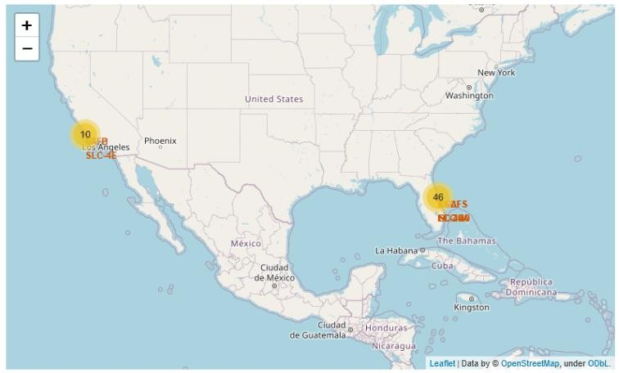
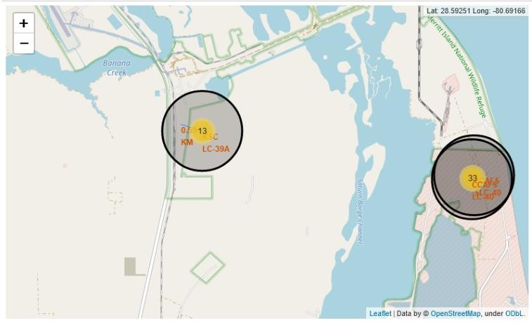
Results
Interactive analytics enabled the identification of launch sites typically located in safe areas, such as near the sea, and surrounded by robust logistical infrastructure. The majority of launches took place from sites on the east coast.

Slide 19
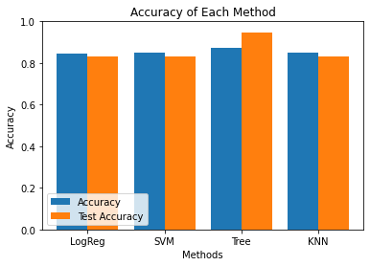
Results
From the predictive analysis, the Decision Tree Classifier emerged as the most accurate model for predicting successful landings, with an accuracy exceeding 87% for the training set and surpassing 94% for the test data.

Slide 20


Slide 21
Flight Number vs. Launch Site
The graphical analysis indicates that currently, the most successful launch site is CCAFS SLC 40, demonstrating a high rate of successful recent launches. Following in effectiveness are VAFB SLC 4E and KSC LC 39A. Additionally, there is a visible trend showing that the overall success rate of launches has been on an upswing over time.

Slide 22
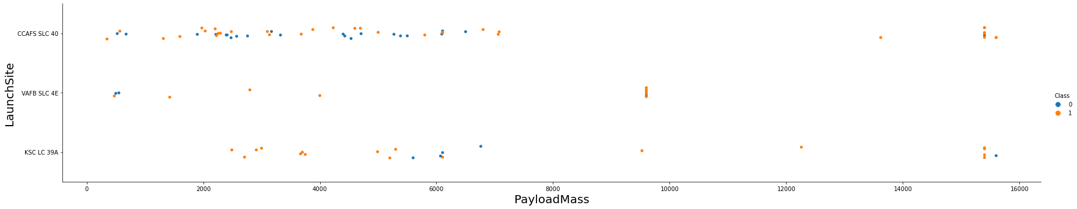
Payload vs. Launch Site
In terms of payload capacity, rockets carrying payloads over 9,000 kg, which is roughly equivalent to the weight of a school bus, have an excellent success rate. However, the capability to send payloads exceeding 12,000 kg is apparently exclusive to launches from CCAFS SLC 40 and KSC LC 39A.

Slide 23
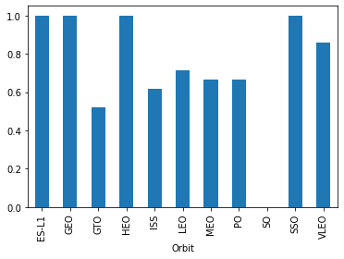
Success Rate vs. Orbit Type
Orbital success rates are highest for missions targeting the ES-L1, GEO, HEO, and SSO orbits. Other orbits with notable success rates include VLEO, with over 80% success, and LFO, with success rates above 70%.

Slide 24
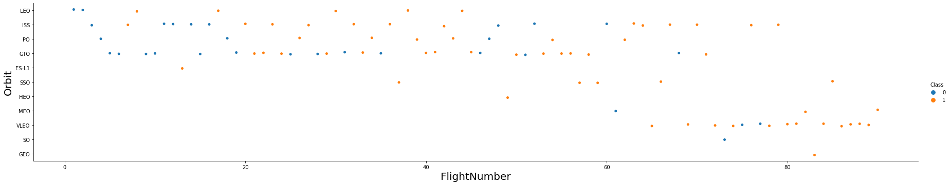
Flight Number vs. Orbit Type
The data analysis indicates the following:
There has been an overall improvement in success rates across all orbits over time, suggesting advancements in launch reliability and technology.
The VLEO (Very Low Earth Orbit) has emerged as a new area of business opportunity, likely due to its increasing launch frequency.

Slide 25
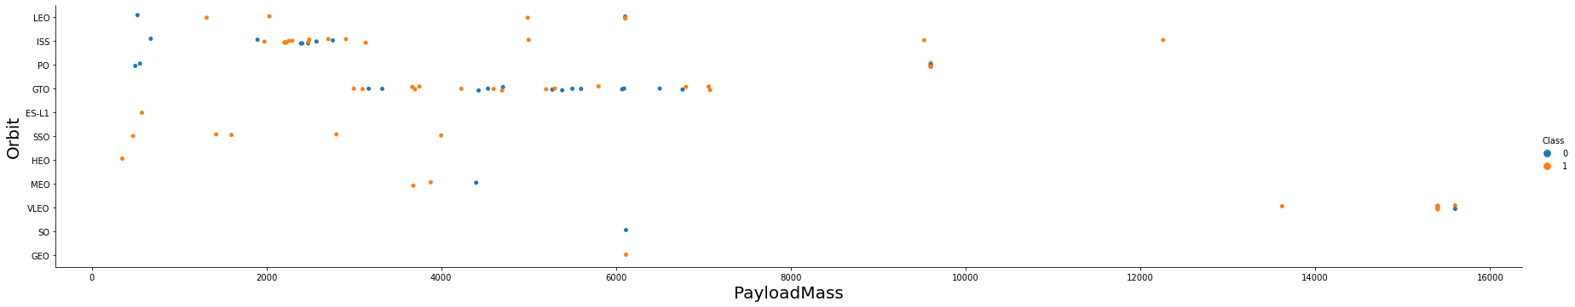
Payload vs. Orbit Type
There seems to be no direct correlation between the payload mass and the success rate for GTO (Geostationary Transfer Orbit) missions.
The ISS (International Space Station) orbit demonstrates the ability to accommodate the widest range of payload masses while maintaining a good success rate.
There have been a limited number of launches to SO (Suborbital) and GEO (Geostationary Orbit) orbits, which could suggest either a lesser demand or a more specialized use case for these orbits.

Slide 26
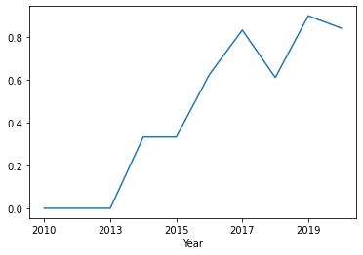
Launch Success Yearly Trend
The increase in success rates started around 2013 and continued consistently until 2020.
It appears that the initial years of this period were marked by significant adjustments and improvements in spaceflight technology, contributing to the later success.

Slide 27
All Launch Site Names
According to data, there are four launch sites:
Launch Site
CCAFS LC-40
CCAFS SLC-40
KSC LC-39A
VAFB SLC-4E
The extraction of specific data points was conducted through the following processes:
Unique launch site identifiers were determined by selecting distinct "launch_site" values from the dataset..

Slide 28
Launch Site Names Begin with 'CCA'
5 records where launch sites begin with `CCA`:
Date | Time UTC | Booster Version | Launch Site | Payload | Payload Mass kg | Orbit | Customer | Mission Outcome | Landing Outcome
2010-06-04 | 18:45:00 | F9 v1.0 B0003 | CCAFS LC-40 | Dragon Spacecraft Qualification Unit | 0 | LEO | SpaceX | Success | Failure (parachute)
2010-12-08 | 15:43:00 | F9 v1.0 B0004 | CCAFS LC-40 | Dragon demo flight C1, two CubeSats, barrel of Brouere cheese | 0 | LEO (ISS) | NASA (COTS) NRO | Success | Failure (parachute)
2012-05-22 | 07:44:00 | F9 v1.0 B0005 | CCAFS LC-40 | Dragon demo flight C2 | 525 | LEO (ISS) | NASA (COTS) | Success | No attempt
2012-10-08 | 00:35:00 | F9 v1.0 B0006 | CCAFS LC-40 | SpaceX CRS-1 | 500 | LEO (ISS) | NASA (CRS) | Success | No attempt
2013-03-01 | 15:10:00 | F9 v1.0 B0007 | CCAFS LC-40 | SpaceX CRS-2 | 677 | LEO (ISS) | NASA (CRS) | Success | No attemp
Here we can see five samples of Cape Canaveral launches.

Slide 29
Total Payload Mass
Regarding the total payload carried by NASA boosters:
Total Payload (kg)
111.268
The total payload was calculated by summing all payloads associated with codes containing 'CRS', indicative of NASA's Commercial Resupply Services.

Slide 30
Average Payload Mass by F9 v1.1
In relation to the average payload mass for the Falcon 9 v1.1 booster:
Avg Payload (kg)
2.928
The dataset was filtered for the specific booster version mentioned. Subsequently, the average payload mass was computed, resulting in a value of 2,928 kg.

Slide 31
First Successful Ground Landing Date
First successful landing outcome on ground pad:
Min Date
2015-12-22
By applying a filter to the dataset for successful landings on a ground pad and selecting the earliest date from the resulting data, the initial successful ground landing was pinpointed to December 22, 2015.

Slide 32
Successful Drone Ship Landing with Payload between 4000 and 6000
When identifying boosters that had achieved successful landings on a drone ship with a payload mass greater than 4,000 kg but less than 6,000 kg, the filter criteria produced four distinct booster versions that met these conditions.
Booster Version
F9 FT B1021.2
F9 FT B1031.2
F9 FT B1022
F9 FT B1026

Slide 33
Total Number of Successful and Failure Mission Outcomes
Number of successful and failure mission outcomes:
Mission Outcome | Occurrences
Success | 99
Success (payload status unclear) | 1
Failure (in flight) | 1
The compilation and quantification of mission outcomes, categorized into their respective groups, produced the summarized data previously noted.

Slide 34
Boosters Carried Maximum Payload
Regarding the boosters with the maximum payload mass, a specific selection was made from the dataset to identify those that have carried the heaviest payloads.
Booster Version (...)
F9 B5 B1048.4
F9 B5 B1048.5
F9 B5 B1049.4
F9 B5 B1049.5
F9 B5 B1049.7
F9 B5 B1051.3
Booster Version
F9 B5 B1051.4
F9 B5 B1051.6
F9 B5 B1056.4
F9 B5 B1058.3
F9 B5 B1060.2
F9 B5 B1060.3

Slide 35
2015 Launch Records
Failed landing outcomes in drone ship, their booster versions, and launch site names for in year 2015
Booster Version | Launch Site
F9 v1.1 B1012 | CCAFS LC-40
F9 v1.1 B1015 | CCAFS LC-40
The list above has the only two occurrences.

Slide 36
Rank Landing Outcomes Between 2010-06-04 and 2017-03-20
Ranking of all landing outcomes between the date 2010-06-04 and 2017-
03-20:
Landing Outcome | Occurrences
No attempt | 10
Failure (drone ship) | 5
Success (drone ship) | 5
Controlled (ocean) | 3
Success (ground pad) | 3
Failure (parachute) | 2
Uncontrolled (ocean) | 2
Precluded (drone ship) | 1
This view of data alerts us that “No attempt” must be taken in account.

Slide 37


Slide 38
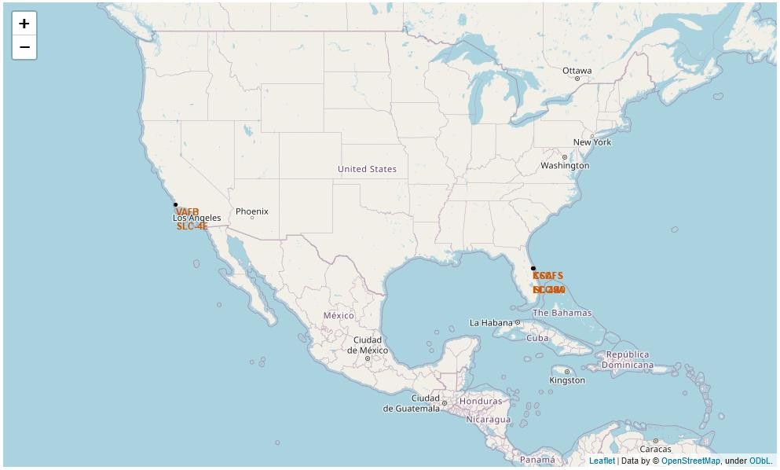
All launch sites
Launch sites are near sea, probably by safety, but not too far from roads and
railroads.
38

Slide 39

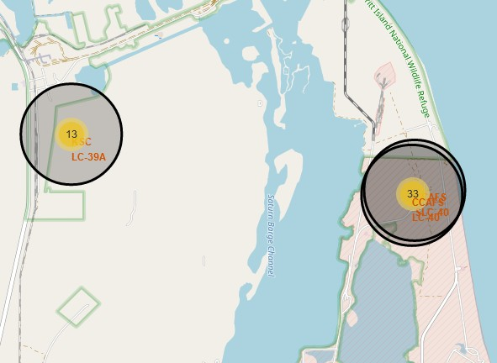
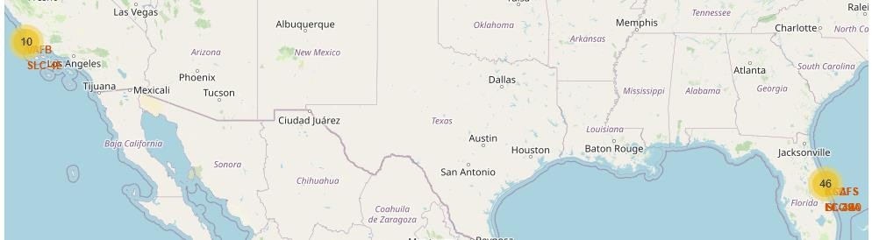

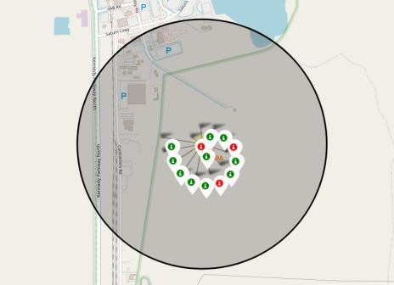
Launch Outcomes by Site
Example of KSC LC-39A launch site launch outcomes
Green markers indicate successful and red ones indicate failure.

Slide 40
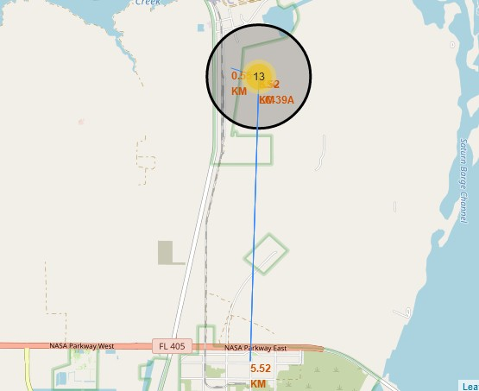
Logistics and Safety
The selection of launch sites appears to be a strategic balance between safety requirements and logistical convenience. Proximity to the sea is likely for safety considerations, offering a clear area where rocket stages can fall without risk to populated areas.

Slide 41


Slide 42
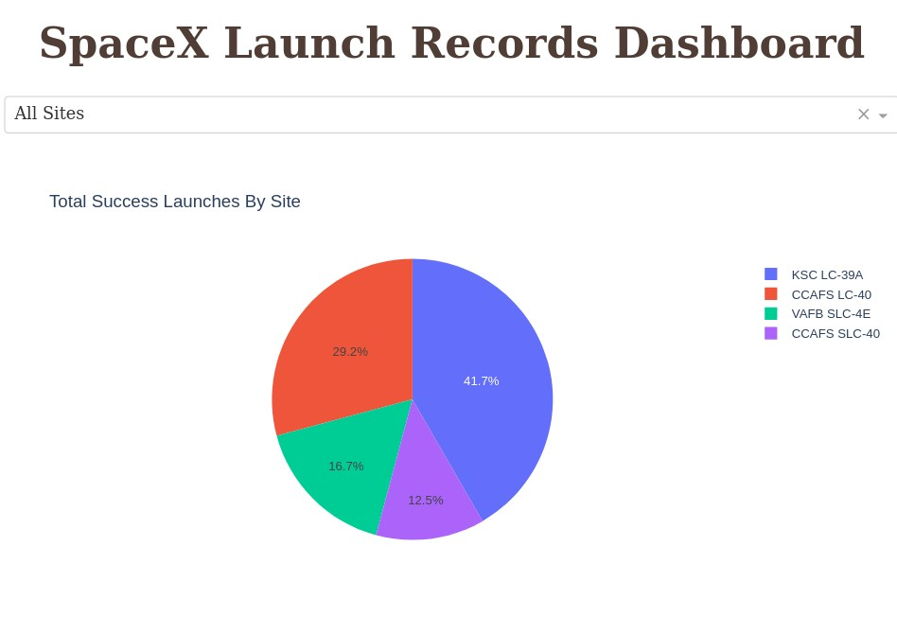
Successful Launches by Site
The place from where launches are done seems to be a very important factor of
success of missions.

Slide 43
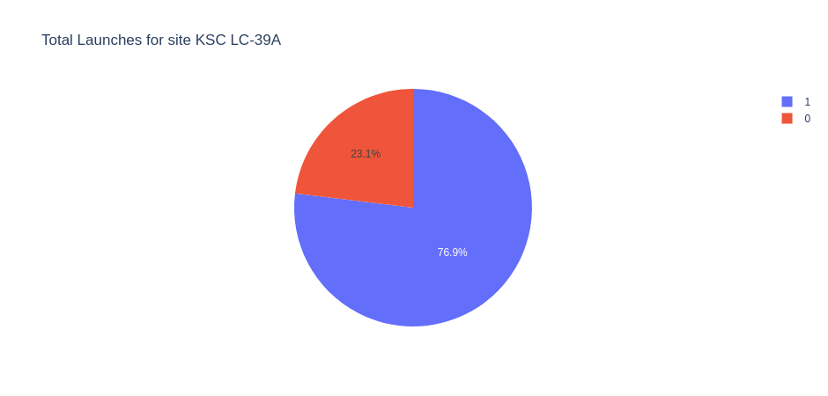
Launch Success Ratio for KSC LC-39A
76.9% of launches are successful in this site.

Slide 44
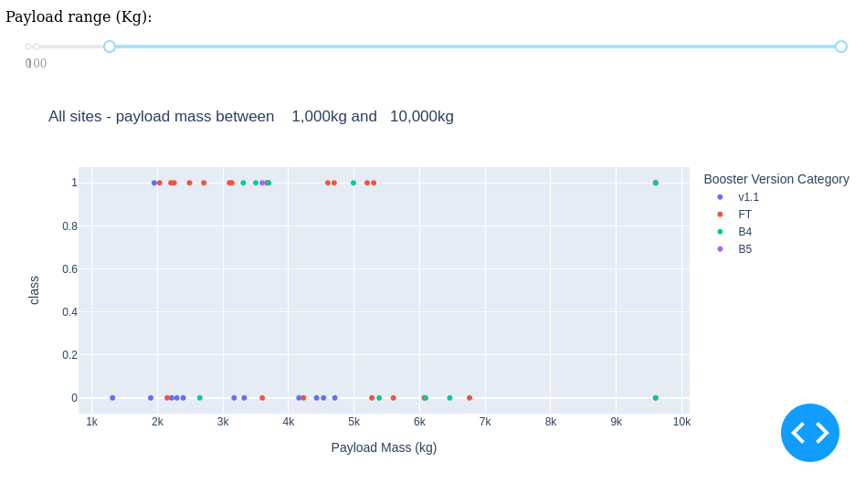
Payload vs. Launch Outcome
. Lastly, payloads weighing less than 6,000 kilograms combined with FT (Falcon 9 Full Thrust) boosters have emerged as the most successful pairing, suggesting this specific booster is well-suited for payloads of this mass range.

Slide 45
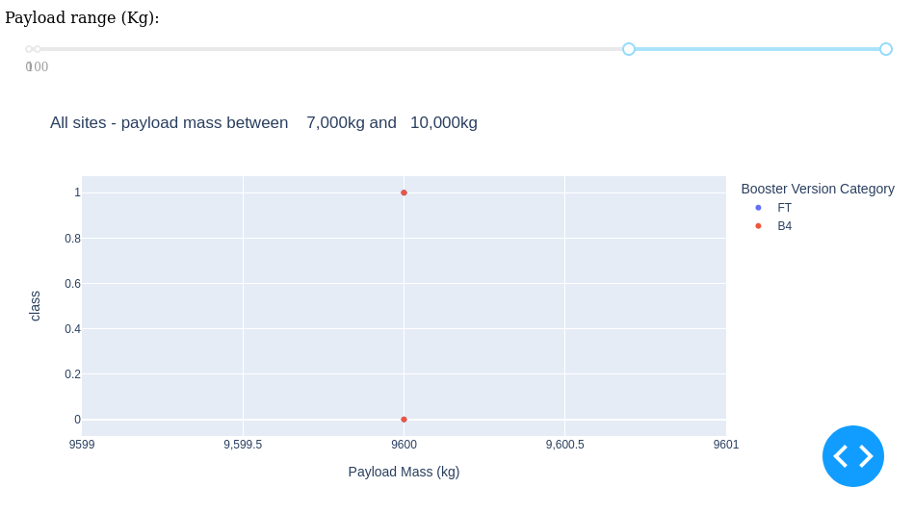
Payload vs. Launch Outcome
There’s not data to estimate the risk of launches over 7,000kg

Slide 46


Slide 47
Classification Accuracy
A comparative analysis of four distinct classification models was undertaken, with their accuracy rates depicted graphically alongside each model.
The Decision Tree Classifier emerged as the most accurate model, demonstrating an impressive accuracy rate of over 87%.

Slide 48
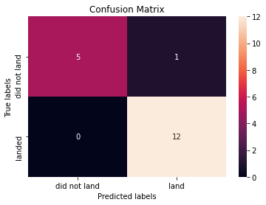
Confusion Matrix of Decision Tree Classifier
The effectiveness of the Decision Tree Classifier is further confirmed by the confusion matrix, which shows a predominance of correct predictions, both true positives and true negatives, over incorrect ones.

Slide 49
Conclusions
The investigation incorporated multiple data sources, leading to refined conclusions. The KSC LC-39A site stood out as the optimal location for launch activities. It was noted that payloads heavier than 7,000kg tend to be less risky. Consistently successful mission outcomes are seen, likely due to advancements in processes and rocket technology. Employing the Decision Tree Classifier could aid in forecasting successful landings, potentially boosting profitability.

Slide 50
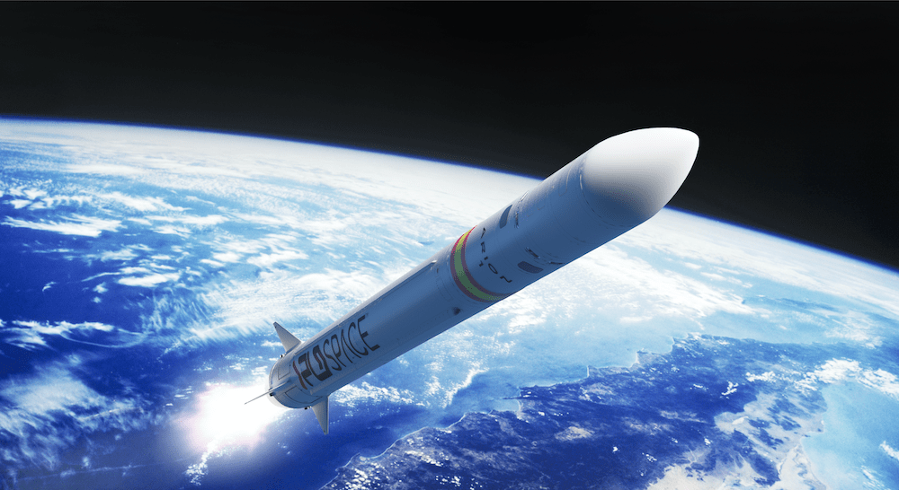
Thank you!

